Slide 1
COURSE
SAFETY IN CONSTRUCTION INDUSTRY
BSS –DIPLOMA & Adv. Diploma

Slide 2
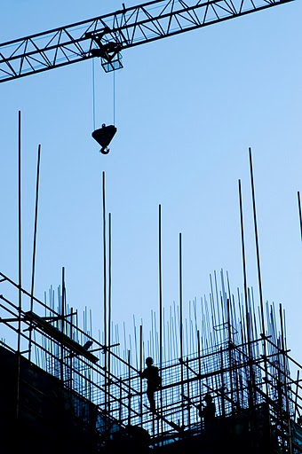
UNIT–I
INTRODUCTION TO CONSTRUCTION SAFETY
Scope of Construction
Construction includes:
Building works
Renovations
Maintenance activities
Demolition work
Covered by ILO standards:
Safety and Health in Construction Convention 1988 (C167)
Safety and Health in Construction Recommendation 1988 (R175)

Slide 3
Construction Hazards
Falls from height
Fragile roofs
Falling objects, slips, trips
Excavations
Demolition
Explosives
Working in or over water
Working in tunnels
Vehicles
Traffic movements
Plant and equipment
Doors and gates
Lighting & Weather
Stability
Fire
Material storage

Slide 4
Excavation
Excavation – a man-made cut, cavity, trench, or depression formed by earth removal.
Whether you want to construct a commercial or a residential building, roadways, bridges, or install pipes and underground utility lines, the land needs to be inspected and prepared to ensure it provides a strong foundation. Excavation is an important part of any construction project. The process uses different tools and techniques to move soil, rock, and other material to form a cavity and prepare the area for construction. Building companies use several different types of excavation in construction. The type of excavation used depends on the material used and the purpose.

Slide 5
Excavation by Material
Topsoil Excavation
As the name suggests, this type of excavation involves the removal of the exposed or the topmost area of the earth’s surface. The excavation method removes vegetation, soil, and any other decaying material that could make the land unsuitable to bear structural loads.
Rock Excavation
This type of excavation is used to clear surfaces; like the rocky surfaces that impede the building process. Rock excavation is highly challenging as compared to the other types. This is because it cannot be done without the use of special equipment and techniques like drilling or blasting to remove the rock or clear a tough surface.
Muck Excavation
Muck, the combination of soil and water, is often undesirable during construction and needs to be removed. Muck excavation is named after the material being removed. The muck is either moved to another area or spread out to dry.
Earth Excavation
To create a foundation for buildings and bridges or construct drainage ditches various layers of earth need to be removed. Earth excavation includes the removal of soil; the layer below the topsoil, for the purpose of construction.

Slide 6
Excavation by Purpose
Cut and Fill Excavation
Also known as stripping excavation, this type of excavation in construction is used to clear large areas. The process involves the removal of wide and shallow layers of topsoil, rocks, sand, and other unwanted materials. The procedure may also include grading the land.
Trench Excavation
In this type of excavation, the length of the excavated area exceeds the depth. Trench excavation is typically used to bury service lines, to install pipelines and sewer systems, or lay foundations. Shallow trenches of less than 6m or deep trenches of more than 6m are done using this type of excavation. The techniques used for this type is dependent on factors like the purpose, ground conditions, number of obstructions, and so on.
Basement Excavation
Basement is typically the area below the ground level. This type of excavation is used when the construction is to be done at least partially below the ground level. Depending on the size of the property, this type of excavation can be complicated.
Dredging
Sediment deposits can build up over time under water making construction, as well as the passage, difficult. The process of dredging involves excavating and removing sediments and debris from underwater to allow boats and ships to pass easily and for other construction purposes.

Slide 7
Excavation Hazards
Cave-ins are the greatest risk
Other hazards include:
Asphyxiation due to lack of oxygen
Inhalation of toxic materials
Fire
Moving machinery near the edge of the excavation can cause a collapse
Accidental severing of underground utility lines
Water accumulation
Access/Egress
Falls
Mobile equipment
Over Running Of Vehicles
Persons Falling Into The Excavation
Materials Falling Into Excavations
Undermining Adjacent Structures

Slide 8
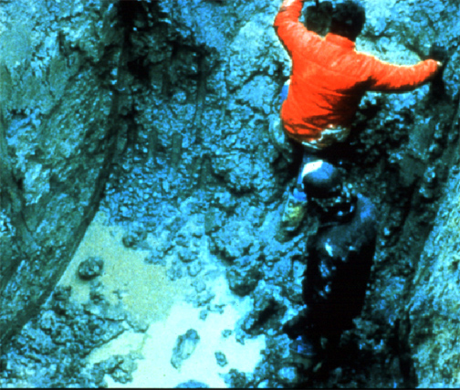
Water is Hazardous
When water is present in an excavation it is extremely hazardous to enter
Note that these workers are not wearing hardhats to protect them from materials falling into the trench

Slide 9
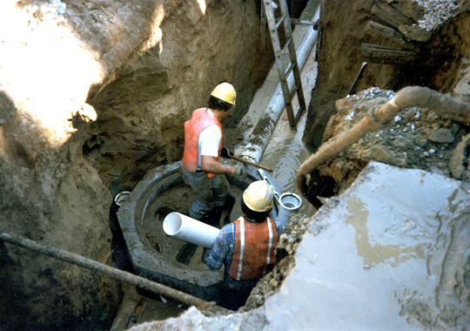
Water = Cave-in Hazard
These workers must be protected from cave-in. Note the water in the bottom of the trench. This is a very hazardous condition!

Slide 10
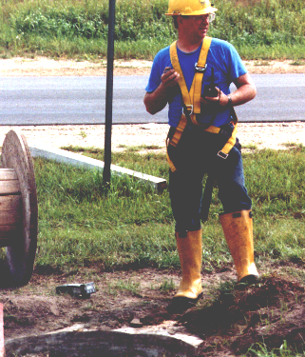
Hazardous Atmosphere
Test excavations more than 4 feet before an employee enters the excavation for:
Oxygen deficiency
High combustible gas concentration
High levels of other hazardous substances

Slide 11
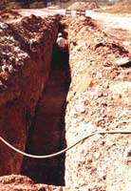
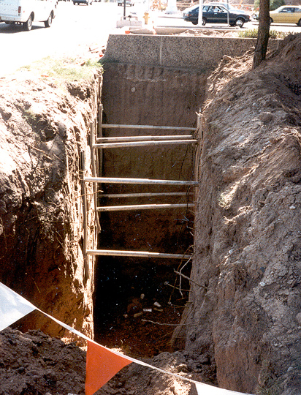
Cave-in Hazard
This excavation has inadequate support posts and egress access
This worker is in a trench with no protective system, that is not sloped or benched and has no means of egress
Inadequate protective system

Slide 12
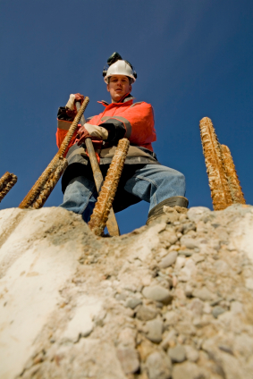
PREVENTIVE MEASURES
PROPER INSPECTION
PROVIDE SIGN BOARD
BARRICADING
SUITABLE SIDE WALL PROTECTION SYSTEM (SLOPING & BENCHING, SHORING, SHIELDING)
DE-WATERING SYSTEM
PROPER PPE
CONDUCT GAS TEST (O2, CO, H2S, METHANE )
REMOVED SOIL AWAY FROM THE SIDE
ACCESS LADDER
EFFECTIVE TRAINING ON EXCAVATION SAFETY
EFFECTIVE SUPERVISION
COMPETENT USERS
PLAN OF THE AREA
DETECTION EQUIPMENT, E.G. METAL DETECTORS & CABLE DETECTORS

Slide 13
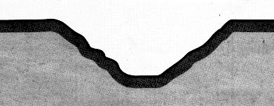
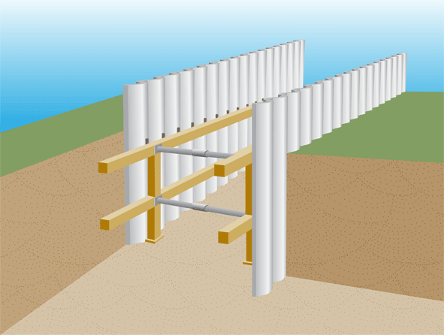
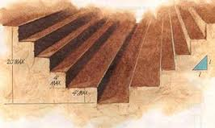
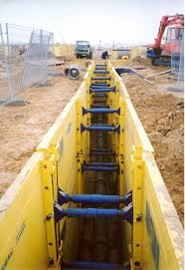
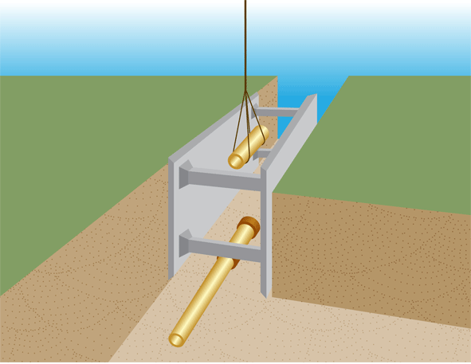
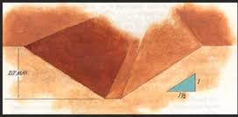
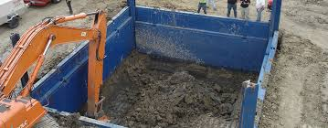
Precautions Prevention of Collapse
Battering
Shoring
Trench box

Slide 14
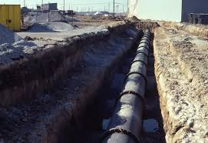
EXCAVATION PROTECTION SYSTEM
BENCHING
A METHOD OF PROTECTING EMPLOYEES FROM CAVE-INS BY EXCAVATING THE SIDE S OF AN EXCAVATION TO FORM ONE OR A SERIES OF HORIZONTAL STEPS

Slide 15
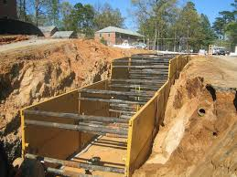
EXCAVATION PROTECTION SYSTEM
SHORRING
HYDRAULIC, TIMBER OR MECHANICAL SYSTEM THAT SUPPORT THE SIDES OF AN EXCAVATION , DESIGNED TO PREVENT CAVE-INS

Slide 16
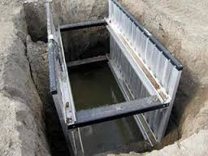
EXCAVATION PROTECTION SYSTEM
SHIELDING
A STRUCTURE THAT IS ABLE TO WITH STAND THE FORCES IMPOSED ON IT BY CAVE-INS, AND IN THE PROCESS, PROTECTS EMPLOYEES INSIDE THE STRUCTURE

Slide 17
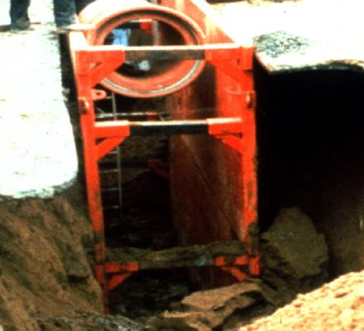
Factors Involved in Designing a Protective System
Soil classification
Depth of cut
Water content of soil
Changes due to weather and climate
Other operations in the vicinity

Slide 18
Shoring
General
Provides a framework to work in
Uses Wales, cross braces and uprights
Supports excavation walls
OSHA tables provide shoring data
Must know soil type
Must know depth and width of excavation
Must be familiar with the OSHA Tables

Slide 19
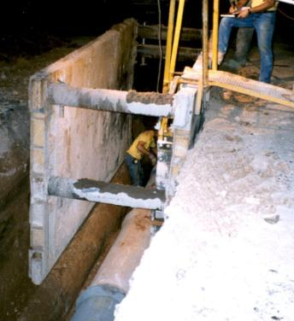
Trench Shield
A trench shield was built around this work area

Slide 20
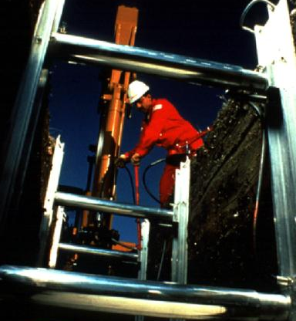
Hydraulic Trench Support
Using hydraulic jacks the operator can easily drop the system into the hole
Once in place, hydraulic pressure is increased to keep the forms in place
Trench pins are installed in case of hydraulic failure

Slide 21
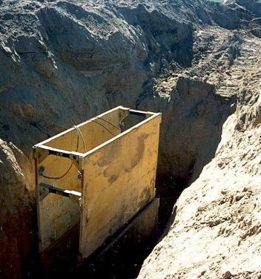
Materials and Equipment
Equipment used for protective systems must not have damage or defects that impair function.
If equipment is damaged, the competent person must examine it to see if it is suitable for continued use.
If not suitable, remove it from service until a professional engineer approves it for use.

Slide 22
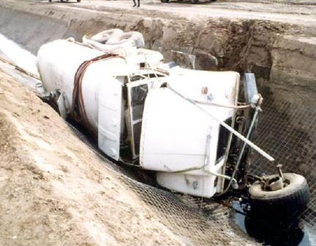
Protection from Vehicles
Install barricades
Hand/mechanical signals
Stop logs
Grade soil away from excavation
Fence or barricade trenches left overnight

Slide 23
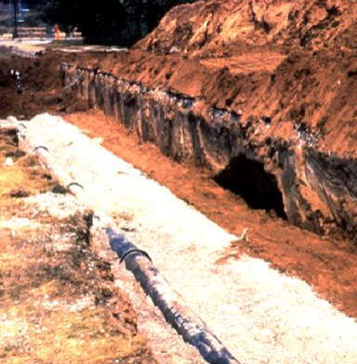
Spoils
Don’t place spoils within 2 feet from edge of excavation
Measure from nearest part of the spoil to the excavation edge
Place spoils so rainwater runs away from the excavation
Place spoil well away from the excavation

Slide 24
SITE CONDITION SHALL BE CHEKED BEFORE STARTING EXCAVATION
TRAFFIC
NEAREST STRUCTURES AND THEIR CONDITION
SOIL TEST
OVER HEAD AND UNDER GROUND UTILITIES ( TELEPHONE LINES,ELECTRONIC LINES,WATER LINES, OTHER PIPE LINES )

Slide 25
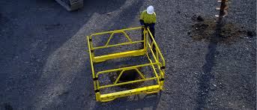
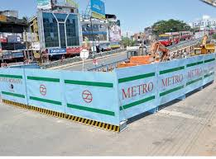

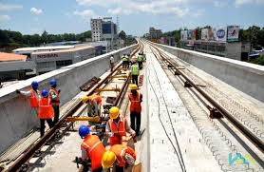
EXCAVATION
PROTECTION OF PEOPLE FALLING
BARRICATION AND TOE BOARD
GOOD LIGHT AND SIGN
CROSSING POINT
ACCESS LADDER
LADDER TO EXTANTS 1 MTR ABOVE EDGS OF EXCAVATION

Slide 26
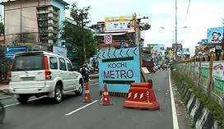

EXCAVATION
PROTECTION FROM VECHICLES
FENCE OR BARRICATION
HAND OR MECHANICAL SIGNAL
STOP LOGS
GRADE SOIL AWAY FROM EXCAVATION
GOOD LIGHTS

Slide 27
Protection from Falls, Falling Loads, and Mobile Equipment
Install barricades
Use hand / mechanical signals
Grade soil away from excavation
Fence or barricade trenches left overnight
Use a flagger when signs, signals and barricades are not enough protection

Slide 28
Competent Person
Must have had specific training in and be knowledgeable about:
Soils classification
The use of protective systems
The requirements of the standard
Must be capable of identifying hazards, and authorized to immediately eliminate hazards

Slide 29
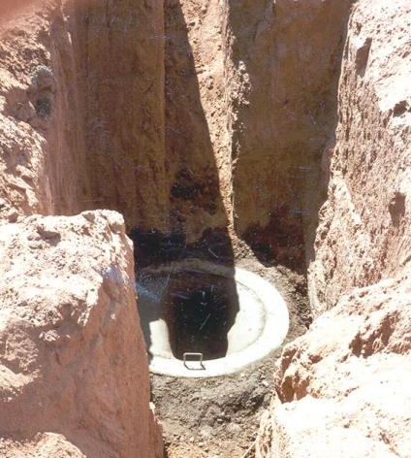
Inspections of Excavations
A competent person must make daily inspections of excavations, areas around them and protective systems:
Before work starts and as needed,
After rainstorms, high winds or other occurrence which may increase hazards, and
When you can reasonably anticipate an employee will be exposed to hazards.

Slide 30
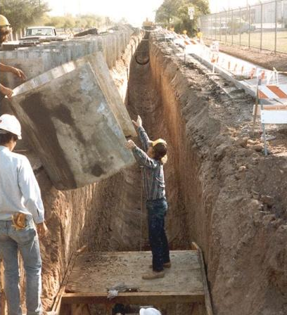
Inspections of Excavations
If the competent person finds evidence of a possible cave-in, indications of failure of protective systems, hazardous atmospheres, or other hazardous conditions:
Exposed employees must be removed from the hazardous area
Employees may not return until the necessary precautions have been taken

Slide 31
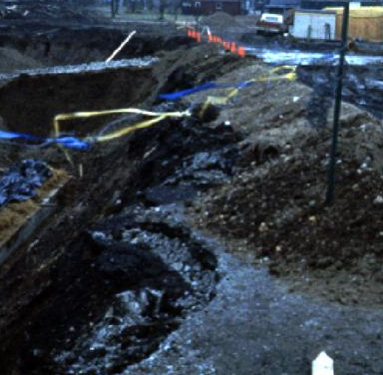
Site Evaluation Planning
Before beginning excavation:
Evaluate soil conditions
Construct protective systems
Test for low oxygen, hazardous fumes and toxic gases
Provide safe in and out access
Contact utilities
Determine the safety equipment needed

Slide 32
What is Piling?
Piling is defined as being foundations that are driven or bored through the ground along a certain length of area to carry and transfer loads to soil considered to be weak in structure due to the soil conditions. Essentially this means that piles are generally used when the bearing capacity of the soil is considered to be inadequate for the structural load of heavy construction. The piles transfer the load to the solid ground located at a depth.

Slide 33
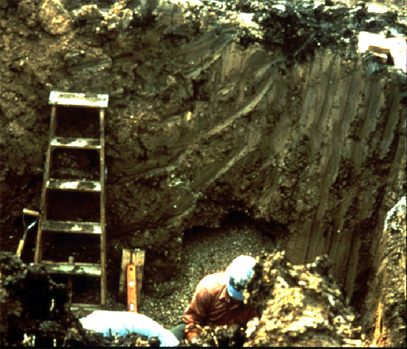
Means of Egress
A stairway, ladder, or ramp must be present in excavations that are 4 or more feet deep, and within 25 feet of the employees
The ladder should extend 3 feet above the excavation

Slide 34
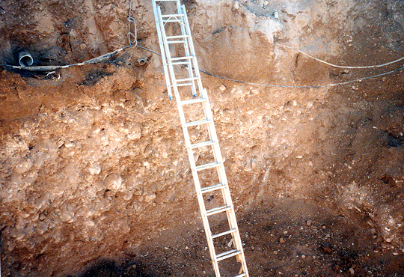
Access and Egress
These two ladders which are lashed together are not an adequate means of egress
The ladder should extend 3 feet above the top of the excavation

Slide 35
EXCAVATION
GENARAL TIPS
ANY EXCAVATION OR TRENCH 4 FEET OR DEEPER SHALL BE CONSIDERED ON A CONFINED SPACE
IF THE WORK ARROUND THE TRAFFIC PEDESTRIAN SAFETY VERY IMPORTANT
A COMBITANT PERSON INSPECT EXCAVATION ON DAILY CHECK ADJACENT AREA FOR POSSIBLE CAVE-IN FAILAURE OF PROTECTIVE SYSTEM AND EQUIPMENT, HAZHADOUS ATMOSPHERE OR OTHER HAZARDOUS CONDITION.
IDENTYFY THE UNDER GROUND UTILITIES BY USING SITE MAP, UTILITIES DETECTORS, SIGN BOARD AND ROUTE MARKS

Slide 36
Summary
The greatest risk in an excavation is a cave-in.
Employees can be protected through sloping, shielding, and shoring the excavation.
A competent person is responsible to inspect the excavation.
Other excavation hazards include water accumulation, oxygen deficiency, toxic fumes, falls, and mobile equipment.

Slide 37
UNIT–II
INTRODUCTION TO FABRICATION YARD
Metal fabrication is the creation of metal structures by cutting, bending and assembling processes. It is a value-added process involving the creation of machines, parts, and structures from various raw materials.
Typically, a fabrication shop bids on a job, usually based on engineering drawings, and if awarded the contract, builds the product. Large fab shops/yard employ a multitude of value-added processes, including welding, cutting, forming and machining.
As with other manufacturing processes, both human labor and automation are commonly used. A fabricated product may be called a fabrication, and shops specializing in this type of work are called fab shops/yard.

Slide 38
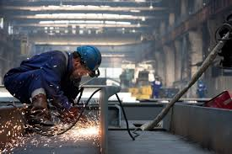
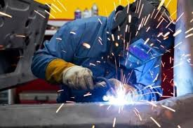
HOT WORK
DEFINITION
ANY WORK WHICH INVOLVE THE USE OF NAKED FLAME OR A SOURCE OF IGNITION OR SPARK GENARATING POTENTIAL, CAPABLE OF IGNITING A COMBUSTIBLE OR EXPLOSIVE MATERIALS IS CLASSIFIED AS HOTWORK

Slide 39
Hot Work - Potential Hazardous Consequences
Property Damage (Fire / Explosion)
Creating an ignition source (flame, heat, sparks, non-intrinsically safe equipment, molten metal or direct flames) in a combustible atmosphere (flammable materials/vapors) leading to fire or explosion.
Caution must be taken when working near openings or cracks in walls, flooring, open doorways and windows.
Impinging heat to surrounding process equipment, causing possible thermal expansion resulting in the release of hydrocarbons,
Arc from welding, possibly setting off fire detection / mitigation systems (i.e., deluge systems, alarms resulting in possible unit shut downs, etc.)
Interference with other simultaneous work in close proximity (e.g., work involving breaking containment and potential release of combustible gases while hot work is present.)

Slide 40
Hazards associated with welding equipment:
Damage and defective parts, if not replaced prior to start of the job
Improper grounding
Oxy-fuel equipment
If oxy-acetylene cylinders do not have sufficient material in the cylinders pre-or to start of the job, backflow can happen if one cylinder goes empty during operation which can cause:
A system pressure imbalance.
Mixing of oxy and fuel inside the hose.
Flashback caused by reverse flow of gas through the torch and back through to the hose, regulator and/or cylinder, potentially causing an explosion
Fire or explosion caused by ignition of flammable/combustible vapors/materials present in processing equipment such as tanks, vessels and piping, etc., that have void spaces or liners (i.e., double-walled tanks and piping, double-bottom tanks)

Slide 41
Personal Injury (Safety / Human Health)
Hot work presents direct personnel hazards to those involved in the task, or working nearby.
Skin/eye burns and electric shock are potential direct hazards. A hot surface or a spark can burn skin, either by contact or from radiated heat. The eyes are particularly sensitive to burning, including that from light radiation - “arc eye”.
Potential of personnel overexposure to welding or flame cutting fumes, especially:
If ventilation is inadequate.
Inappropriate or insufficient PPE.
Injuries from sparks, etc., to personnel working in the area or passing nearby (or at a lower level below the work) may occur if the area is not properly isolated or access is restricted and there is no additional protection such as a fire blanket.
While the direct hazards of hot work are important, the risks from fires and explosions are typically more significant, especially in operational areas.

Slide 42
Chemical Release / Environmental Impact (On-Site)
In addition to the Property Damage and Personal Injury consequences stated above, facilities must also consider the potential for escalation that could result in environmental damage or additional personal injuries occurring on-site.
Environmental damage due to releases to the air, soil, or bodies of water resulting from hot work related fires, explosions, equipment damage, etc.
Personnel injuries due the release of flammable, combustible vapors, or toxic materials due to products of combustion resulting from hot work related fires.
Personal injuries due to fire escalation or explosions resulting from hot work related fires.

Slide 43
Chemical Release / Environmental Impact (Off-Site)
In addition to the Property Damage and Personal Injury consequences stated above, facilities must also consider the potential for escalation that could result in environmental damage or additional personal injuries occurring on-site.
Environmental damage due to releases to the air, soil, or bodies of water resulting from hot work related fires, explosions, equipment damage, etc.
Personnel injuries due the release of flammable, combustible vapors, or toxic materials due to products of combustion resulting from hot work related fires.
Personal injuries due to fire escalation or explosions resulting from hot work related fires.

Slide 44

SAFETY ARRANGEMENTS
BOOTH PREPARATION
PROPER INSPECTION
CHECK THE HOT WORK PERMIT
TEST FOR OXYGEN LEVEL
TEST FOR LEL
TRAINED/ EXPERIENCED WORKER
PROPER SUPERVISION
KEEP COMBUSTIBLE AWAY
FIRE WATCH AND SUITABLE EXTINGUISHER
PROPER VENTILATION & ILLUMINATION
PROPER HOUSEKEEPING

Slide 45
Blasting Procedure
The Blast Cleaning Abrasive shall be Natural Garnet, which shall be dry and free of oil, grease and other harmful materials at the time of use.
All areas that can be injured by the blast shall be protected by suitable masking.
Clean, dry compressed air shall be used for nozzle blasting. Moisture separators, oil separators, traps or other equipment may be necessary to achieve this requirement.
The minimum pressure at the nozzle of the pressure type blasting machine should be 80-100 psi.
Material being blasting shall have at least 3 degree above the dew point.
Blasting shall not be carried-out if Relative Humidity is above 85%.

Slide 46
Blast angle should be as close perpendicular as possible but in no case greater than + 30⁰ to the work surface. Over blasting must be avoided.
Clean, dry and oil free air shall be used to remove grit from the blasted area after blasting. It may be necessary by soft brush or by vacuum cleaning.
The blasted area shall be free of all visible oil, grease, dirt, dust, mill scale, rust, paint oxides, corrosion products and other foreign matter.
The surface shall be uniformly blasted to Sa 2½ for External surfaces and Sa 3 for Internal surfaces as per the Scope of work.
Only clean gloves, rags or slings shall be used in handling blasted materials or in contact with blasted surfaces.
Clean, dry, oil free air shall be used to remove grit from the vessels after blasting. It may be necessary to clean by brushing or vacuuming.

Slide 47
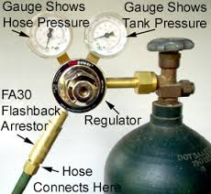

INSPECT TOOLS AND EQUIPMENTS
ELECTRIC DEVICE- INSULATED AND EARTHED
GAS CYLINDER- UP RIGHT POSITION
GAS REGULATER AND PRESSURE GAUGE- GOOD CONDITION
FLASH BACK ARRESTOR
FIRST-AID KIT
BARRICADE AND SIGN BOARD

Slide 48
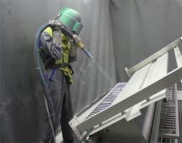
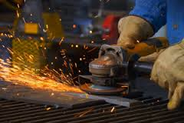
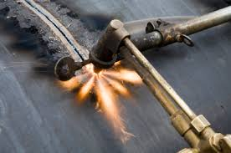
FIRE WATCH
DEFINITION
A PERSON WHO IS ASSIGNED AS LOOKOUT IN HOT WORK JOB
E.g. WELDING
CUTTING
GRINDING

Slide 49
UNIT– III
INTRODUCTION TO WORK AT HEIGHT
If only I was wearing a safety harness !!

Slide 50
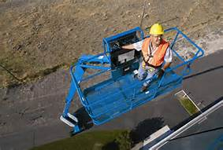

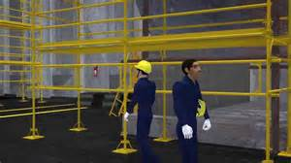
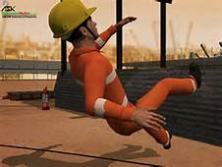
DEFINITION
WORK THERE IS A RISK OF FALL LIABLE TO CAUSE INJURY
ANY WORK ABOVE 1.8 METER FROM GROUND IS CAUSED WORK AT HEIGHT

Slide 51
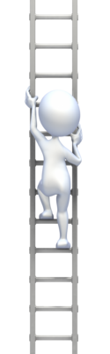
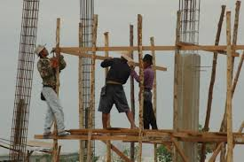
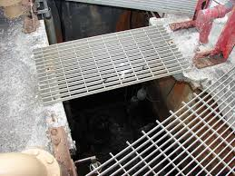
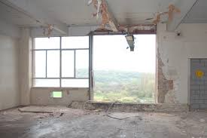
Work at height means work in any place where, if precautions were not taken, a person could fall down and injure themselves.
Work above ground level.
Working near a floor opening or unprotected edge

Slide 52
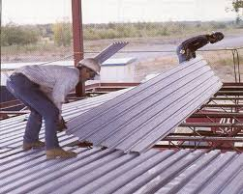
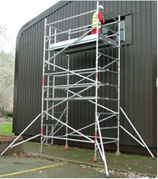
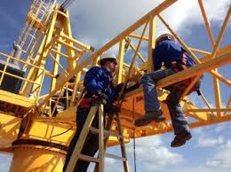
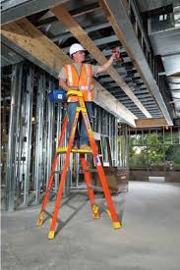
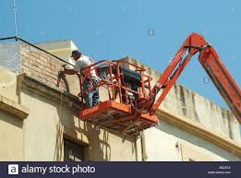

Examples of working at height
Using working platforms such as scaffolds, tower.
Scaffolds, cherry pickers, scissor lifts and podium steps.
Work on a roof, piece of plant or equipment.
Using ladders or stepladders.

Slide 53

WORK AT HEIGHT
HAZARDS OF WORK AT HEIGHT
VERTICAL HEIGHT
FALLING METERIALS
WEATHER
UN PROTECTED EDGS
SLOPPING ROOFS

Slide 54



WORK AT HEIGHT
RESULT OF FALLING FROM HEIGHT
FATALITY
SPINAL INJURY
MULTIPLE BROKEN BONES

Slide 55




WORK AT HEIGHT
CONTROL MEASURE FOR WORKING AT HEIGHT
TRAINING
BARRICATION
FULL BODY HARNESS
SAFETY NETS
PFAS-PERSONAL FALL ARREST SYSTEM
GUARD RAILS

Slide 56
SCAFFOLDNG

Slide 57
SCAFFOLDNG
DEFINITION
SCAFFOLDING IS A TEMPORARY ELEVATED PLATFORM MADE FOR SAFELY WORKING AT HEIGHT.
INTRODUCTION
IT IS ESTIMATED THAT 2.3 MILLION CONSTRUCTION WORKERS DEAL WITH SCAFFOLDIG EATCH YEAR. MORE THAN 10000 WORKERS ARE INJURED AND 80 ARE KILLED IN SCAFFOLDING RELATED ACCIDENTS.

Slide 58

Scaffolding
Using ladders or scaffolding without proper fixing is crazy
Putting up scaffolding, removing ties and taking it down again is a job for trained and experienced scaffolders. Leave it to them
Never use incomplete scaffolding always inspect before use
Make sure there is safe access, hand rails and toe boards at all edges
Things fall on sites, wear your helmet

Slide 59


Mobile Scaffold Towers
Before Erection:
Check all components are in good condition
Check wheels for effective rotation
Check brakes and locking devices work correctly
Prior to erecting towers on suspended floors, ensure bearing capacity of floor is sufficient for the planned load
Before Use:
Ensure the tower is vertical and square
Towers must not be used unless the wheels are locked
Check that outriggers are set correctly and secured
Ensure the platform is fully boarded out and guardrails and toe boards are fitted if working platform is over 2 meters

Slide 60
TYPES OF SCAFFOLDS
FRAME SCAFFOLDING
TUBE AND CLAMP
MODULAR SYSTEM SCAFFOLDS
ROLLING SCAFFOLDING (MOBILE SCAFFOLDS)
SUSPENDED SCAFFOLDIND

Slide 61


TYPES OF SCAFFOLDS
FRAME SCAFFOLDING

Slide 62


TYPES OF SCAFFOLDS
TUBE AND CLAMP

Slide 63



TYPES OF SCAFFOLDS
MODULAR SYSTEM SCAFFOLDS

Slide 64


TYPES OF SCAFFOLDS
ROLLING SCAFFOLDING (MOBILE SCAFFOLDING)

Slide 65


TYPES OF SCAFFOLDS
SUSPENDED SCAFFOLDIND

Slide 66
TYPES OF SCAFFOLDING ( BASED ON WORKING LOAD)
LIGHT DUTY SCAFFOLD
MEDIUM DUTY SCAFFOLD
HEAVY DUTY SCAFFOLD
SPECIAL DUTY SCAFFOLD

Slide 67

LIGHT DUTY SCAFFOLD
A SCAFFOLD DESIGNED AND CONSTRUCTED TO CARRY A WORKING LOAD NOT TO EXCEED 150kg/ M2

Slide 68

MEDIUM DUTY SCAFFOLD
A SCAFFOLD DESIGNED AND CONSTRUCTION TO CARRY A WORKING LOAD NOT TO EXCEED 200 kg/M2

Slide 69

HEAVY DUTY SCAFFOLD
A SCAFFOLD DESIGNED AND CONSTRUCTED TO CARRY A WORKING LOAD NOT TO EXCEED 250kg/M2

Slide 70

SPECIAL DUTY SCAFFOLD
SCAFFOLD DESIGNED AND CONSTRUCTED TO CARRY SPECIFIC TYPE OF OBJECTS

Slide 71




COMMON PARTS OF SCAFFOLD
SOLE BOARD/ SILLS
BASE PLATE
STANDARD/ POST
LEDGER
BRACE
TRANSOM
COUPLER
WORKING PLATFORM
GUARD RAILS
ACCESS LADDER

Slide 72


COMMON PARTS OF SCAFFOLD
SOLE BOARD/SILLS
SILVER OAK WOODEN PLANK SUPPORRT BASE PLATE AT GROUND.

Slide 73

COMMON PARTS OF SCAFFOLD
BASE PLATE
IT IS A MILD STEEL SQUARE-PLATE

Slide 74

COMMON PARTS OF SCAFFOLD
STANDARD/POST
IT IS VERTICAL SCAFFOLD TUBE

Slide 75

COMMON PARTS OF SCAFFOLD
LEDGER
IT IS HORIZONTAL SCAFFOLD TUBE

Slide 76


COMMON PARTS OF SCAFFOLD
BRACE
A TUBE PLACED TO THE VERTICAL AND HORIZONTAL MEMBERS OF A SCAFFOLD AND FIXED TO THEM TO GIVE STABILITY.

Slide 77


COMMON PARTS OF SCAFFOLD
TRANSOM
TUBES FIXED AT RIGHT ANGLE ACROSS THE LEDGERS, ADJACENT TO EATCH PAIR OF STANDAEDS TO SUPPORT THE SCAFFOLD BOARDS

Slide 78

COMMON PARTS OF SCAFFOLD
COUPLER
A DEVICE FOR LOCKING TOGETHER COMPONENT PARTS OF TUBE AND COUPLER SCAFFOLD .

Slide 79







COUPLER
TYPES OF COUPLERS

Slide 80


COMMON PARTS OF SCAFFOLD
WORKING PLATFORM
AN ELEVATED WORK SURFACE COMPOSED OF ONE OR MORE PLATFORM UNITS.

Slide 81

COMMON PARTS OF SCAFFOLD
GUARD RAILS
TOP RAIL
MID RAIL
TOE BOARD

Slide 82
COMMON PARTS OF SCAFFOLD
GUARD RAILS- HEIGHT
TOP RAIL
MID RAIL
TOE BOARD
 | 70 CM |  | TOTAL- 110 CM
 | 40 CM
 | 15 CM

Slide 83
HAZARDS- SCAFFOLDING
FALL FROM SCAFFOLD DURING ERACTION
FALL FROM WORKING PLATFORM
ELECTROCUTION- FROM OVERHEAD POWER LINES
FALLING OBJECT
SCAFFOLD COLLAPSE

Slide 84
CAUSE OF SCAFFOLD COLLAPSE
OVER LOAD WORK PLATFORM
SOFT GROUND
NOT TIED IN PROPERLY
BRAZING INSAFFICENT
HIGH WIND
INCORRECT COUPLAR
SCAFFOLD ERECTED BY INCOMPETANT WORKERS
SCAFFOLD NOT INSPETED PRIOR TO USE

Slide 85
SAFETY ARRAGEMENTS -SCAFFOLD
USE APPROPRIATE SCAFFOLD CONSTRUCTION METHOD
PROPER INSPECTION
TRAINED AND CERTIFIED WORKER
NOT EXCEED SAFE LOAD
ERECTION ON A LEVEL GROUND
10 FEET SAFE DISTANCE FROM POWER LINE
PROPER FALL PROTECTION SYSTEM

Slide 86
SCAFFOLD FALL PROTECTION SYSTEM
GUARD RAIL
TOP RAIL
MID RAIL
TOE BOARD
TRAINING
BARRICATION
FULL BODY HARNESS
SAFETY NETS
SAFETY MONITORING
PFAS – PERSONAL FALL ARREST SYSTEM

Slide 87

SCAFFOLD FALL PROTECTION SYSTEM
FULL BODY HARNESS

Slide 88

FULL BODY HARNESS
PARTS OF HARNESS

Slide 89


SCAFFOLD FALL PROTECTION SYSTEM
SAFETY NETS

Slide 90
SCAFFOLD INSPECTION CHECK LIST
CHECK FOR MISSING PLANKS ON PLATFORM
CHECK FOR MISSING GUARD RAIL SYSTEM
CHECK FOR PROPER ACCESS
CHECK FOR HOUSE KEEPING ON SCAFFOLD PLATFORM (LOOSE MATERIALS, WORKING WASTE ETC…)
CHECK FOR PROPER TYING OFF BUILDING

Slide 91



SCAFF TAG SYSTEM
THREE TYPES OF SCAFF TAG
RED TAG – DON’T USE
GREEN TAG – OK TO USE
YELLOW TAG – CHECK WITH SUPERVISOR
IF THERE IS NO SCAFF TAG DON’T USE THE SCAFFOLD

Slide 92


LADDER
HAZARDS OF LADDERS
DON’T STAND LADDER ON DRUM, BOX OR OTHER UNSTABLE BASE
NEVER ATTEMPT TO REPAIR BROKEN LADDER
NEVER CARRY LOAD UP LADDER HOIST IT UP
WHEN USING THE METEL LADDER, , MAKE SURE THERE ARE NO ELECTRICAL HAZARD IN THE NEAR VICINITY
FALLING OFF THE LADDER

Slide 93


LADDER
SAFE LADDER PLACING
LADDER SHOULD BE SET AN ANGLE OF ABOUT 75 OR ONE METER FOR EVERY FOUR METER RISE

Slide 94
LADDER
LADDER-SAFETY
USE ONLY APPROVED LADDERS
INSPECT BEFORE USE
ONE PERSON ONLY
USE FALL ARREST IF > 6 FT WORKING FROM LADDER
EXTEND 3 FEET ABOVE ACCESS OR WORKING LEVEL
USE 4:1 LEAN RATIO
USE 3 POINT CONTACT

Slide 95

LADDER
LADDER SAFETY

Slide 96


LADDER
MONKEY LADDER

Slide 97


Slide 98


✓
Ascending/descending without holding
handrails
Always hold handrails while
Ascending/descending

Slide 99


✓
Safety Harness not anchored, Unsafe working platform
Safety harness anchored, Safe working platform

Slide 100


✓
Mobile Scaffold not approved (Green Tag), Brake not engaged
Working on approved scaffold (Green tag), Brake engaged while working on mobile scaffold

Slide 101
✓
Unsafe access provided to work area
Safe access provided with a approved Green Tag.

Slide 102


✓
No edge protection/handrails provided
Handrails / edge protection provided

Slide 103


✓
Properly tied ladder, 1 meter projection, Proper footing, 3-point contact
Ladder insufficient length for the purpose, No edge protection

Slide 104

✓
Deep excavation crossing ,Use of crossing points, Fall prevention measure, Protected edges
Unsafe access for deep excavations or no cross over

Slide 105


✓
Platform missing on the scaffold
Fully boarded platform

Slide 106


✓
Ladder at incorrect angle, person to hold the ladder, Ladder not tied, Ladder not extended on top by at least 1 meter
Ladder at correct angle, person to hold the ladder

Slide 107


✓
Top rail & mid rail missing
Top rail & mid rail provided

Slide 108


✓
Floor opening on pedestrian route, Unsafe penetration
Protected floor opening on access routes, Hole cover demarked

Slide 109


✓
Unsafe working platform
Safe working platform

Slide 110

✓
Unsafe ladder for the activity, No person holding the ladder
Straight ladder being used, Person holding the ladder

Slide 111

✓
Working on red tagged scaffold, Brakes not engaged while working on mobile scaffold
Working on approved scaffold (Green tag), Brake engaged while working on mobile scaffold

Slide 112


✓
Red Tag – Do not use scaffold
Green Tag – Scaffold safe to use

Slide 113


✓
Tool carried in hand while climbing scaffold
Use safe method for shifting tools

Slide 114


✓
Ensure fall protection provided while working at edge
Working at edge without any fall protection

Slide 115


✓
Safety harness anchored at lower point
Proper anchoring point

Slide 116
UNIT– IV
INTRODUCTION TO MATERIAL HANDLING
What is Materials Handling?
Moving goods or materials within short distances in a storage area is known as material handling (called by some materials handling). The activity includes loading, unloading, palletizing (storing and transporting goods stacked on pallets, shipped as unit loads), as well as, de-palletizing and a number of similar operations. Fork-lift trucks are the equipment used most frequently in material handling.

Slide 117


MANUAL HANDLING

Slide 118



MANUAL HANDLING
MANUAL HANDLING HAZARDS
TWISTING AND TURNING
HEAVY LOAD
DROPPING LOAD
SHARP EDGGES
HOT LOAD

Slide 119



MANUAL HANDLING
MANUL HANDLING INJURIES
BACK INJURIES
MUSCULAR SPRAIN
CUTS AND ABRASION
FRACTURE
OPEN INJURIES
SWELLING
HERNIA
WRULDS (WORK-RELATED-UPPER-LIMB-DISORDERS)
CUTS, BURNS, DISLOCATIONS AND BROKEN BONES

Slide 120

Manual Handling Risk Assessment
Load
Individual
Task
Environment
Remember: LITE
Notes:
No manual handling activity is completely safe but using the HSE manual handling assessment charts as part of a well thought out risk assessment, will reduce the risks from manual handling activities.
The Task:-
does it involve twisting, stooping, bending, excessive travel, pushing, pulling or precise positioning of the load, sudden movement, inadequate rest or recovery periods, team handling or seated work?
The Individual:-
Does the individual require unusual strength or height, are they pregnant, disabled or suffer from a health problem, or require specialist knowledge or training?
The Load:-
Is the load heavy, unwieldy, difficult to grasp, sharp, hot, cold, difficult to grip, are the contents likely to move or shift?
Environment:-
Space constraints, uneven, slippery or unstable floors, and variations in floor levels extremely hot cold or humid, poor lighting, poor ventilation, gusty winds, clothing or PPE that restricts movement?
The Manual Handling Operations Regulations 1992
These regulations require employers to establish a clear hierarchy of measures to be taken by both the employer and employees.
The employer should:
avoid the need for hazardous manual handling as far as is reasonably practicable by considering alternative ways of working, e.g. automation or mechanization
assess the risks of injury from hazardous manual handling that cannot be avoided. This can be done in-house to find out ways of making the work easier, less risky and less physically demanding
reduce the risk of injury to the lowest level reasonably practicable. This means to reduce risks until the cost of further precautions in time, money or trouble would be too great in proportion to the benefits.
The employee should:
follow appropriate systems of work laid down for their safety
make proper use of equipment provided for their safety
co-operate with their employer on health and safety matters
inform the employer if they identify hazardous manual handling activities
take care to ensure their activities do not put others at risk.

Slide 121
Load
The Individual
Physical weight
Size of the load
Shape of the load
Centre of gravity of the load
Outside surfaces
Stability of contents
Other hazards - hot/cold/sharp etc
Sex
Physical strength
Stature (Appearance, Weight; Height, etc.)
State of health
Level of training
Hazards to pregnant women
Perception of their ability
Notes:
Heavy
Bulky/unwieldy
Difficult to grasp
Unstable
Contents liable to shift
Hot
Sharp
Dangerous

Slide 122
Task
The Environment
Twisting/stooping/reaching
Bending
Distances involved
Pulling and pushing of load
Repetitive handling
Gripping of the load
Insufficient rest or recovery period
Awkward positions
Lighting
Ventilation Obstacles
Height of work surfaces
Temperature (Hot/Cold)
Floor conditions
Space available
Notes:
Holding the load away from the trunk
Twisting the trunk
Stooping
Reaching upwards
Excessive lifting or lowering distances
Handling whilst seated
Excessive carrying distances
Excessive pushing or pulling of the load
Repetitive handling
Insufficient rest or recovery periods
Work rate imposed by a process
Team handling

Slide 123
Practical Measures to Avoid Manual Handling Injuries
Avoid Manual Handling
Risk Reduction
c) Automation & mechanisation
d) Team handling
e) Training
f) Smaller, lighter load
g) Selection (individual and mechanical aid)
h) Good Environment (spacing ; flooring; temp; light)
If load is too heavy get HELP!!!
Notes:
This will form the basis of your manual handling risk
assessment and you should concentrate on:
the handling tasks they are doing;
the loads they are lifting;
the environment they are working in;
the individual capabilities of each worker.
Risk Reduction:
Mechanical assistance
Organisation of work system, work station or task
Changes to the load
Changes to the work environment
Proper design of pushing and pulling tasks

Slide 124



Safe Lifting Techniques
Before lifting
Check the load
Plan the route of the carry
Establish a firm grip
The lift
Bend the knees and use the leg muscles to lift
Keep the back upright
Keep the load close to the body
Avoid twisting, over-reaching, jerking
Setting down
Use the same principles as lifting
Maintain good balance
Set the load down and then adjust its position using body weight

Slide 125

FORK LIFT

Slide 126
FORK LIFT
FACTORS THAT MAY CAUSE A FORKLIFT TRUCK TO OVERTURN
DRIVING AROUND CORNERS TOO QUICKLY
UNEVEN LOADING OF THE FORK
DRIVING WITH THE LOAD ELEVATED , ESPECIALLY WHEN GOING AROUND CORNERS
UNEVEN TYRE PRESSURE
EXCESSIVE BREAKING
DRIVING ACROSS A SLOPE RATHER THAN STRAIGHT UP OR DOWN THE SLOPE
COLLISION , ESPECIALLY WITH KERBS

Slide 127






FORK LIFT

Slide 128


FORK LIFT
FORKLIFT SAFETY
USE SAFE SPEED
BE AWARE OF FORK POSITION
WATCH OUT THE BLIND SPORTS
SLOW DOWN AND SOUND HORN AT THE CORRNER
CERTIFIED FORKLIFT OPERATORS ONLY
INSPECT THE FORKLIFT BEFORE EATCH SHIFTS

Slide 129

FORK LIFT
PRE- USE – CHECK – FORKLIFT
TYRE PRESSURE
PARKING BRAKES
STEERING
FUEL, OIL AND WATER SYSTEM FOR LEAKE
BATTERIES
LIFTING AND TILTING SYSTEM
AUDIBLE WARNING
LIGHTS
MIRRORS

Slide 130



FORK LIFT
PARKING RULES FOR A FORKLIFT
APPLY THE HAND BREAK
LOWER THE FORK AND TIP THE FORWARD
REMOVE THE KEY
PARK IT ON LEVEL AREA
DO NOT OBSTRUCT TRAFFIC
DO NOT OBSTRUCT THE PEDESTRIANS WALKWAYS
DO NOT OBSTRUCT THE EMERGENCY ESCAPE ROUTES

Slide 131

CRANE & LIFTING EQUIPMENTS

Slide 132



CRANE
CRANE IS A MECHANICAL DEVICE USED TO HANDLING MATERIALS , STRUCTURE LIFTING AND DISTRIBUTING THE LOAD
TYPES OF CRANES
MOBILE CRANE
HYDRAULIC CRANE
OVERHEAD CRANE
GANTRY CRANE
TOWER CRANE

Slide 133

MOBILE CRANE

Slide 134

HYDRAULIC CRANE

Slide 135

OVERHEAD CRANE

Slide 136


GANTRY CRANE

Slide 137


TOWER CRANE

Slide 138
CRANE & LIFTING
CRANE & LIFTING PTW
TRAFFIC PERMIT
METHOD STATEMENT
JOB SAFETY ANALYSIS
TRAINING REPORT
AREA DROWING
LIFTING PLAN
THIRD PARTY CERTIFICATES
EQUIPMENTS CERTIFICATES
OTHER CERTIFICATES

Slide 139



CRANE
MAJOR CAUSES OF CRANE ACCIDENTS
CONTACT WITH POWER LINES
OVERTURNS
FALLS
MECHANICAL FAILURES

Slide 140
CRANE
HOW DO ACCIDENTS OCCUR
INSTABILITY-UNSECURED LOAD, LOAD CAPACITY EXCEEDEDD, OR GROUND NOT LEVEL OR TOO SOFT
LACK OF COMMUNICATION-THE POINT OF THE OPERATION IS A DISTANCE FROM THE CRANE OPERATOR OR NOT IN FULL VIEW OF THE OPERATOR
LACK OF TRAINING
INADEQUATE MAINTENANCE OR INSPECTION

Slide 141
CRANE & LIFTING
CRANE HAZARDS
IMPROPER LOAD RATING
EXCESSIVE SPEEDS
NO HAND SIGNALS
INADEQUATE INSPECTION AND MAINTENANCE
UNGUARED PARTS
UNGUARED SWING RADIOUS
WORKING TOO CLOSE TO POWER LINES
SHATTERED WINDOWS
NO STEPS/ GUARD RAILS WALKWAYS
NO BOOM ANGLE INDICATOR
NOT USING OUTRIGGERS

Slide 142
CRANE & LIFTING
CRANE OPERATION- SAFETY ARRAGEMENT
PROPER INSPECTION
TRAINED OPERATOR WITH VALID LICENCE
VALID THIRD PARTY CERTIFICATE OF ALL LIFTING GEARS
PROPER BARRICADING AND SINGH BOARD
LOAD RATING CHART & OPERATING MANUVAL IN THE CABIN
NEVER EXCEED SAFE WORKING LOAD (SWL)
6mDISTANCE FROM POWER LINE
EXPERICNCED RIGGERS TEAM

Slide 143
CRANE & LIFTING
CRANE OPERATION- SAFETY ARRAGEMENT
DAILY INSPECTION OF LIFTING GEARS
PROPER COMMUMICATION & SIGNALS
USE TAG LINE , IF NECESSARY

Slide 144

CRANE & LIFTING
WHO IS RIGGER SUPERVISOR
RIGGER SUPERVISOR IS A PERSON WHO HAS OVERALL CONTROL OF LIFTING OPERATION , MUST BE TRAINED AND EXPERIENCED

Slide 145



CRANE & LIFTING
RIGGING EQUIPMENTS & SLINGS
WIRE ROPE
FIBER ROPE
SYNTHETIC WEB SLING
WIRE ROPE WEB SLING
CHAIN BLOCK
D- SHACKLES
I- BOLTS
LIVER HOIST ( CHAIN PULLER)

Slide 146






CRANE & LIFTING
RIGGING EQUIPMENTS & SLINGS

Slide 147






CRANE & LIFTING
COLOUR CODE – WEB SLINGS
1 TON | VIOLET
2 TON | GREEN
3 TON | YELLOW
4 TON | GRAY
6 TON | BROWN
10 TON | RED

Slide 148

CRANE & LIFTING
CRANE OPERATION- SAFETY TIPS
NEVER WALK OR STAND UNDER ANY SUPENDED LOAD
ALL SIGNAL MUST BE RECEIVED FROM AUTHORIZED SIGNAL MEN
BAD WEATHER – STOP LIFTING ( HIGH WIND AND RAIN)
THIRD PARTY CERTIFICATION OFF ALL LIFTING EQUIPMENTS

Slide 149

Lifts and Hoists
Hazards:
Falling objects
Being struck by the load
Entanglement in moving parts
Falls from height
Failure of the chains, slings etc.
Being struck by moving parts of the hoist.
Materials falling from a platform.

Slide 150



Lifts and Hoists
Chain hoist
Goods hoist
Patient hoist

Slide 151

Lifts and Hoists
Precautions:
Suitable for its intended use
Preventing people getting
underneath the lift platform
Maximum safe working load
Safety devices, e.g. brakes working
Competent operators
Information, instruction and training
Routine maintenance
Routine inspection and thorough examination
Clear visibility of landings
No loose materials
Area Barricade and signage
No passengers on a goods hoist

Slide 152





UNIT– V
INTRODUCTION TO TOOLS
TOOLS

Slide 153


A tool is any instrument or simple piece of equipment that you hold in your hands and use to do a particular kind of work. For example, spades, hammers, and knives are all tools.
TOOLS AND EQUIPMENTS ARE THREE TYPES
HAND TOOLS
POWER TOOLS
PNEUATICTOOLS

Slide 154
TOOLS
COMMON HAZARDS
ELECTRIC SHOCK
FLASH BURNS
FALLING
HAND AND EYE INJURIES
CUT OR LOSSING A BODY PARTS
ERGONOMIC INJURIES

Slide 155
TOOLS
BASIC TOOLS SAFETY RULES
MAINTAIN REGULARLY
USE RIGHT TOOLS FOR THE RIGHT JOB
INSPECT BEFORE USE
OPERATE ACCODING TO MANUFACTURE INSTRUCTION
USE THE RIGHT PPE’S
USE GUARDS

Slide 156

TOOLS
HAND TOOLS
E.g...
HAMMERS
SCREWDRIVERS
CUTTERS
SPANNERS
HAND TOOLS HAZARDS
HAZARDS ARE USULLY CAUSED BY MISUSE AND IMPROPER MAINTENANCE

Slide 157
TOOLS
HAND TOOLS-SAFETY TIPS
RIGHT TOOLS FOR THE RIGHT JOB
GOOD CONDITION
PROPER CARE AND MAINTANANCE
USE PROPER PPE
AVOID USE OF MUSHROOMED HAMMER AND CHIESSEL

Slide 158

TOOLS
POWER TOOLS
TOOLS WHICH ARE RUN BY ELECTRICAL POWER SUPPLY IS KNOWN AS POWER TOOLS
ELECTRICAL DRILLS
ELECTRICAL GRINDER
JIG SAW
ELECTRICAL CUTTER
POWER TOOL HAZARDS
ELECTRICAL SHOCK
CUT OR LOSSING A BODY PARTS
BROKEN BONES
HIT

Slide 159
TOOLS
POWER TOOLS – SAFETY TIPS
CABLE, PLUGS, ARE IN GOOD CONDITION
TOOLS USE WITH CORRECT POWER SUPPLY
MAKE SURE POWER SUPPLY TO BE PROPER EARTHED
TOOLS MUST BE SWITHCHED OFF BEFORE PLUG IN
USE PROPER PPE
KEEP TOOLS CLEAN AND DRY
DISCONNECT WHEN NOT IN USE
PROPER INSPECTION AND MAINTANANCE

Slide 160


TOOLS
SAFETY TIPS- ANGLE GRINDER
RPM SPEED MUST BE GREATER THAN THE GRINDER SPEED
VALIDITY DATE; DO NOT USE IN CASE OF EXPIRY
ANGLE GRINDER & DISENGAGED DISC

Slide 161


TOOLS
PNEUMATIC TOOLS
POWERED BY COMPRESSED AIR INCLUDES CHIPPER, DRILLS, SANDER.
PNEUMATIC TOOLS HAZARDS
MAIN HAZARD IS GETTING HIT BY TOOLS
NOICE IS AN OTHER HAZARD

Slide 162
TOOLS
PNEUMATIC TOOLS – SAFETY TIPS
AUTHORISED OPERATOR
REGULARLY MAINTAINED AND SERVICED
PROTECTIVE GUARD IS CORRECLY FITTED BEFORE USE
PROPER PPE’S
TURN OF THE MAIN COMMPRESSED AIR SUPPLY LINE BEFORE DISCONNECTING
LEAKAGE OF AIR SHOULDN’T TOUCH BY HANDS
NEVER USE BODY FOR CLANING
KEEP THE TOOL IN HORIZONTAL POSSISSION WHEN CHANGING BITS OR POINTS

Slide 163


Common Injuries from Use of Tools
Arms, Hands and Fingers
Cuts, punctures, crushed, burns, lost
part
Eyes and Face
Loss of sight, cuts
Ears
Hearing loss
Legs, Feet and Toes
Cuts, punctures
Body/Skin
Shock, burns, cuts

Slide 164

General Tool Safety
6 Steps of Hand and Power Tool Safety
Inspect tools for defects or damages prior to use.
Wear the proper personal protective equipment.
Select the correct tool for the job.
Use the tool as per design and purpose
If provided , keep guards secured in place.
Establish a balanced working posture.
Clean the tool after use.

Slide 165

Unsafe Acts
Common Unsafe Acts
Not carrying out pre-use inspection
Not wearing/using proper personal protective equipment
Using defective or damages tools
Improper use of tool, e.g., screw-
driver as a chisel
Removing guards
By-passing/overriding safety
switches

Slide 166

Unsafe Acts
Common Unsafe Acts (continuation)
Unauthorized repair
Carrying power tools by the cord
(electric cable)
Replacing drill bits/grinding discs without unplugging the tool

Slide 167


Unsafe Conditions – Tools
Common Unsafe Hand Tool Conditions
Defective or damaged tools, e.g., cracked or missing handle, chipped screwdriver blade (tip)
Fabricated tools (substandard)
Damaged electrical cords and switches

Slide 168


Unsafe Conditions – Power Tools
Common Unsafe Power Tool
Conditions
Missing handles and/or guards
Defective switches and plugs
Worn out electric cable insulation
Lack of inspection, preventive main-
tenance.
Two-pin plugs

Slide 169


Unsafe Conditions – Workplace
Common Unsafe Workplace Conditions
Poor housekeeping
Wet floors
Stray electrical cables, hoses
Tools or materials on floor
Insufficient illumination
Inadequate (indoor) ventilation

Slide 170

Spanner Safety
Do not use defective tools
If bolt/nut size is in millimeters (or inches), use spanner size in millimeters (or inches) respectively.
Where possible use a box spanner instead of open-end spanner or adjustable spanner.

Slide 171

Spanner Safety
Do not use pipe wrench on bolts or nuts.
Do not use “pipe cheaters” to gain more leverage.
Wipe clean any oil, grease of
moisture from the spanner
before or after using.
Return tools to their stores after
use.

Slide 172


Housekeeping
Keep floor clean and dry
Mop up any liquid spill or wet spot.
Remove any tripping hazard.
Keep tools on work tables, racks
or away from passages.
Lay electrical cables flat on the
floor; remove kinks
If possible, use cable ramps.
If working on the floor, e.g.,
grinding big pipes, barricade
the area.

Slide 173

Working at Heights
Use a tool belt for small tools.
Use a tool pouch or bag to shift tools up/down an elevated work location, e.g., platforms, scaffolds.
Do not carry tools in your hand when going
up/down a ladder or stair.
Do not pass tools to another worker by
throwing them.
Do not carry electrical tools by their electrical
cable.

Slide 174

Power Tool General Safety
Obtain proper training
Operate within the designed limits as recommended by the manufacturer.
Use proper personal protective equipment; wear double eye protection when operating grinders and electric drills.
Store power tools in a clean, dry place
Do not use in wet or damp locations
Work in well-illuminated areas
Unplug when not in use.

Slide 175

Abrasive Tools Safety
Proper training on the safe operation, replacement of abrasive wheel and cleaning .
Unplug abrasive tool prior to replacement of abrasive wheel/disc.
Confirm spindle nut and guards are tightly
secured prior to operation.
Do not press the abrasive wheel/disc against
a hard surface to stop its rotation; allow it to
stop on its own.
Do not apply excessive pressure on the ab-
rasive tool for the purpose of speeding up
the job.

Slide 176


Abrasive Wheel & Disc Inspection
Ring Test (Abrasive Wheel)
Insert index finger in the abrasive wheel
hole
Tap the abrasive wheel with the handle of
a screwdriver
Dull ring sound means abrasive wheel
has cracks; do not use.
Good ring sound mead abrasive wheel
has no cracks: good condition.
Inspection
Visual inspection for cracks, chipped edges, warped
Speed Rating
Disc/Wheel speed (RPM) must be higher than
speed rating of the grinder

Slide 177

Responsibilities
Supervisor
Guide workers on the safe use of tools; including inspection, minor maintenance and in cleaning them before returning to Stores.
Remove defective or damaged tools from site; send for repair, replacement and disposal.
Ensure work area is cleaned after the shift or working day.

Slide 178


Responsibilities
Storekeeper (Material Controller)
Maintain a list (inventory) of tools
Issue only tools that are in
good condition.

Slide 179


Responsibilities
Electrician
Maintain a list (inventory) of power tools
Carry out preventive maintenance
as per schedule.
Carry out corrective maintenance and repair as required.
Provide inspection stickers or tags on all power tools, electric cables.
Recommend replacement or dis-posal of defective/damaged tools

Slide 180


Responsibilities
Worker
Carry out pre-use inspection of tools
Use tools are per design and purpose
Return detective or damaged tools to Storekeeper/Material Controller for replacement.
Carry out housekeeping at the end of each shift/day.

Slide 181

Responsibilities
HSE Advisor
Monitor workplace activity and rectify any near miss, unsafe act or condition.
Carry our random inspection of tools and work area.
Ensure workers are provided with, and are using/wearing, the personal protective equipment appropriate for the job.
Instruct Worker to return detective or damaged tools to Storekeeper/Material Controller for replacement.

Slide 182
Pictorial Do’s and Don’ts

Slide 183




Spanner Size 11/16 inch
Bolt Size 27mm
Spanner Size 27mm
Bolt Size 27mm
No periodic inspection of power tools
Periodic inspection of power tools

Slide 184




Missing Handle
Handle In Place
Missing Guard
Guard In Place

Slide 185




Grinding Wheel with Cracks
Grinding wheel in good condition
RPM range of the wheel is less than the RPM range of the machine
RPM range of the wheel is more than the RPM range of the machine

Slide 186




Grinding without wearing face shield
Grinding and wearing proper PPE
Pneumatic gun operation without wearing ear plug (noisy operation)
Wearing ear protection(noisy operation)

Slide 187




Hammers with chipped head edge and mushroom head
Hammer in good condition
Loose hammer handle
Hammer handle in good condition

Slide 188




Damaged bar bending tool
Bar bending tool in good condition
Wood cutting saw with damaged handle
Wood cutting saw in good condition

Slide 189




Damaged hoses
Hose in good condition
Flash back arrestor not available
Flash back arrestor available

Slide 190




Damaged cable
Cable in good condition
Fabricated (sub-standard) vise
Standard bench wise

Slide 191




Positioning finger close to the pinch point, not wearing PPE
Hand is away from pinch points
Positioning finger in the pinch point
Proper gloves are worn

Slide 192




Two-man operation for a one-man operation machine
One-man operation for a one-man operation machine
Working with non-insulated tool in electrical panel
Working with insulated tool in electrical panel

Slide 193
Summary
Hand and power tools are very common to any industrial facility. They can expose employees to multiple hazards if they are not maintained and used properly.
It is important that you know how to inspect, use/operate and maintain them.

Slide 194

Questions or Clarifications
Thank You

